Slide 1
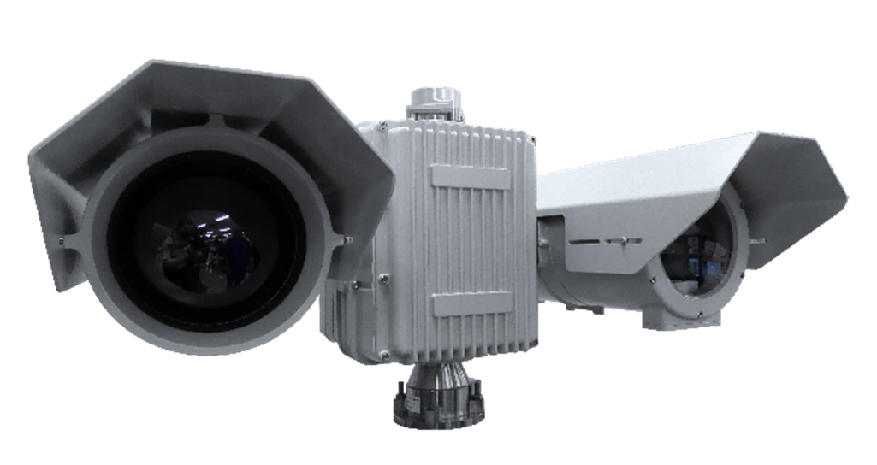
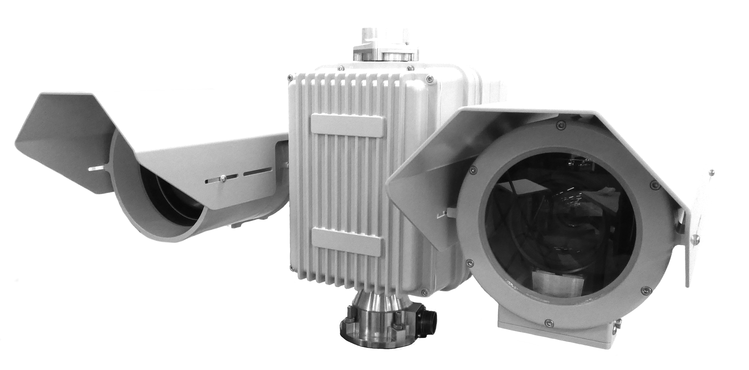
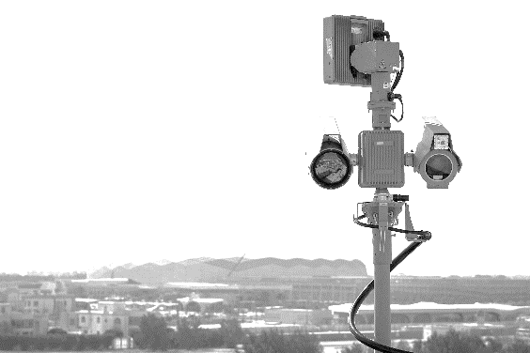
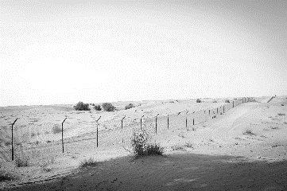
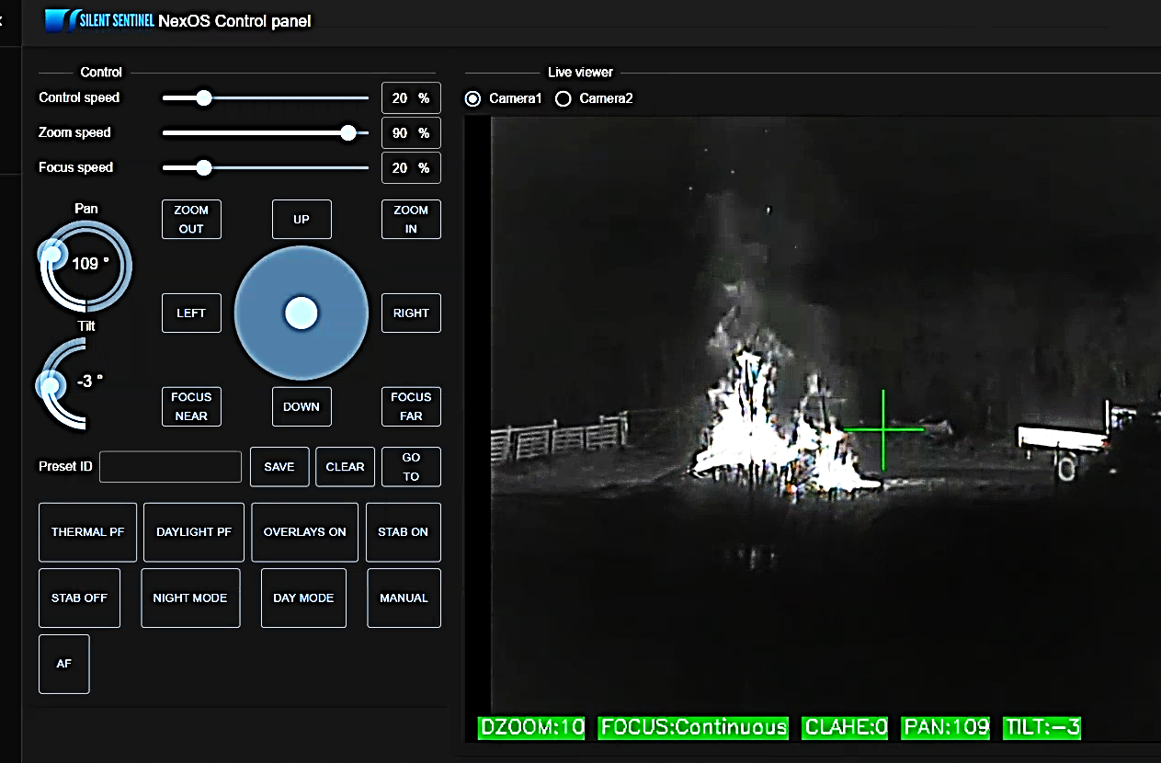
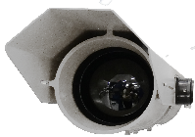
JAEGAR RANGER HD
Powered by
TECHNICAL SPECIFICATION
THERMAL SENSORS | JPTX-EVO2-HD-75-W | JPTX-EVO2-HD-150-W | JPTX-EVO2-HD-225-W | JPTX-EVO2-HD-300-W
Focal Length | 25mm to 75mm | 30mm to 150mm | 25mm to 225mm | 30mm to 300mm
Horizontal FOV | 36.7° (W) to 11.5° (T) | 28.7° (W) to 5.9° (T) | 34.2° (W) to 3.9° (T) | 29.0° (W) to 2.9° (T)
F Number | F1.2 | F1.2 | F1.5 | F1.5
Optical Zoom (Continuous) | 3x, Motorised | 5x, Motorised | 9x, Motorised | 10x, Motorised
Digital Zoom | 20x
Focus | Push autofocus, continuous autofocus, continuous autofocus with automatic ROI, manual
Detector Type | Uncooled VOx microbolometer, ≤50mK (at 25℃, F1.0), 30Hz, 12μm, HD (1280 x 1024)
Spectral Band | 7.5 to 14μm (LWIR / 8 to 14μm)
Image Processing | Correction (NUC), noise filtering, polarity control, Digital Detail Enhancement (DDE), polarity: white hot / black hot, 18x colour palettes
Housing Weight (Typical) | 12Kg / 26.4lb | 26mm to 105mm | 30mm to 180mm | 18.3Kg / 40.4lb
Housing Size (Typical) | L572 x W258 x H226mm | 26mm to 105mm | 30mm to 180mm | L580 x W282 x H257mm
HIGH PERFORMANCE PAN AND TILT UNIT
HD LOW LIGHT VISIBLE ZOOM LENS SENSORS
HD LWIR UNCOOLED THERMAL ZOOM LENS SENSORS
The JAEGAR RANGER EVO2 HD is a high performance, multi sensor platform which utilises long range uncooled LWIR HD thermal sensors with a range of zoom lens options up to 30-300mm, alongside the latest low light HD visible sensors with zoom lens options up to 20-2400mm. The EVO2 range employs the latest 12μm thermal sensor technology and has intelligent capabilities as standard.
Combining advanced motor control technology along with harmonic drive gears, all Jaegar camera platforms are able to position our longest-range sensors accurately and quickly. This is complimented with advanced features* such as video tracking, target classification, dynamic bore-sighting and gyro. The Jaegar benefits from a fixed through shaft, which can enable payloads such as a RADAR to be mounted directly above the Jaegar PTU director.
HD VISIBLE SENSORS
Focal Length | 4.3mm to 129mm | 15.2mm to 500mm
Horizontal FOV | 63.7° (W) to 2.32° (T) | 23.42° (W) to 0.78° (T)
F Number | F1.6 to F4.7 | F3.0 to F32
Optical Zoom (Continuous) | 30x, Motorised | 33x, Motorised
Digital Zoom | 20x | 10x
Focus | Push autofocus, continuous autofocus, continuous autofocus with automatic ROI, manual | Push autofocus, continuous autofocus, continuous autofocus with automatic ROI, manual
Image Sensor | 1/2.8“ CMOS Exmor (2.13MP), full HD 1080p (1920 x 1080) | 1/1.9” CMOS Sensor (2.38 MP), full HD 1080p (1920 x 1080)
Min. Sensitivity | Colour 0.01 lux Mono 0.0008 lux (high sensitivity mode) | Colour 0.05 lux F1.2 gain of up to 60dB / 0.005 lux F1.2 / AGC @ 42dB Mono 0.002 lux F1.2 gain of up to 60dB / 0.0002 lux F1.2 / AGC @ 42dB (accumulation 25 times)
Image Processing | Digital noise reduction
Housing Weight (Typical) | 14Kg / 30.9lb | 17Kg / 37.4lb
Housing Size (Typical) | L572 x W258 x H231mm | L800 x W258 x H231mm
KEY FEATURES
Thermal camera detection ranges up to 9.31km (human) **
HD 12μm thermal sensors with zoom lens options up to 300mm
HD visible sensors with zoom lens options up to 2400mm
intelligence allows advanced image processing and motor control
Procedure Manager and Pelco Query Builder allow advanced configurations
Push, continuous and ROI autofocus, electronic image stabilisation and digital zoom (20x) as standard
360° Continuous rotation with pan and tilt speeds between 0.001° and 200° per second
High level of camera positioning accuracy: 0.0001° / 0.0017 mRad
Unique cable managed, rapid release mechanism and bore sighting allows a quick installation in the field
Through shaft enabling fixed payloads to be mounted above the Jaegar PTU director
System configuration and sensors can be chosen to suit the specific requirements
Ideally suited for single mast deployments such as mobile, border and maritime applications
NexOS*
NexOS Core (Standard) | NexOS Core includes: Push autofocus, continuous autofocus, continuous autofocus with automatic ROI, digital zoom, image contrast enhancements, de-fog, electronic image stabilisation (2D), static overlays, remote upgrades, remote diagnostics
NexOS Performance Pack (Cost Option) | In addition to NexOS Core, includes: Electronic image stabilisation (3D), target tracking, target classification, event detection, dynamic overlays, dynamic boresight, dynamic absolute positioning, edge recording
NexOS Gyro Pack (Cost Option) | In addition to the NexOS Performance Pack, includes: Jaegar NexOS Gyro Pack
NexOS GPS Positioning Pack (Cost Option) | In addition to the NexOS Performance Pack, includes: Jaegar NexOS GPS Positioning Pack
JAEGER PAN AND TILT UNIT (PTU)*
Pan Range / Velocity | 360° Continuous; 0.001° - 200° per second**
Tilt Range / Velocity | -90° to +90°; 0.001° - 200° per second**
Accuracy | 0.0001° / 0.0017 mRad
Repeatability | 0.0001° / 0.0017 mRad
Actuation | Custom stepper motors
Speed Control | Zoom dependent speed control (subject to payload)
Presets Types | Procedural, Positional
Number of Presets | 255
Protocols | Pelco D, ONVIF Profile-S (custom available on request)
Interface | RS485, ONVIF Profile-S, Serial <> IP
Positioning | Absolute positioning feedback
Through Shaft | Yes
PTU Weight (Typical) | 28kg / 61.8lb (excluding mounts, through shaft and payloads, payload capacity 50kg)
PTU Size (Typical) | H434 x W343x D343mm (excluding mounts, through shaft and payloads)
ELECTRICAL AND MECHANICAL
Video Output | RTSP, ONVIF from PTU (H.264, H.265 and MJPEG)
Ethernet | Command and control of all functions including streaming of H.264, H.265 and MJPEG video
RS485 | Pelco D command and control with custom procedural extensions
Rapid Release Mechanism | Yes
Input Voltage | 48VDC
Housing Material | Anodised aluminum, white powder marine grade paint finish (other colours are available upon request)
IP Rating | IP67
Temperature Range | -30°C (-22°F) up to 65°C (149°F) (-40°C with optional heaters)
Above: Typical Jaegar Ranger (models will vary)
* Requires the NexOS performance pack and the gyro options
** Johnsons Criteria, (Human at 1.8m x 0.5m, Detection at 2 pixels, Recognition at 8 pixels and Identification at 13 pixels. 50% probability subject to environmental conditions). Based on the JPTX-EVO2-300-W.
OPTIONALLY AVAILABLE
HD Low Light Visible Sensor | 16.7mm to 2000mm (21.2° W to 0.23° T) (with x2 extender on) 1/1.9” CMOS Sensor (2.38MP), full HD (1920 x 1080), colour 0.005 lux at F1.2 / 42dB mono 0.0002 lux at F1.2 / 42dB
HD Ultra Low Light Visible Sensor | 15.2mm to 500mm (32.39° W to 1.0° T) or 20mm to 2400mm (24.87° W to 0.23° T) (with x2 extender on) 2/3” CMOS Sensor (2.2MP), full HD (1920 x 1080), colour 0.005 lux at F1. 4 / 50IRE, mono 0.000000001 lux at F1.4 / 50IRE
4K Visible Sensor | 4.4mm to 88.4mm (70.2° W to 4.1° T) 1/2.5” CMOS Sensor (8.51MP), 4K/QFHD (3840 x 2160), colour 0.4 lux (colour 0.06 lux with slow shutter on)
Technologies | Long range white light (up to 3.5km) or infra-red illuminators (up to 2.5km), laser illuminators, long range acoustic hailer (up to 2km), digital magnetic compass, SWIR sensors, LRF (laser range finders) up to 20km, wiper for visible cameras
Jaegar PTU Aux Payload Connectors | QTY 2x External connectors allowing for a selection of the following: Power outputs -12vDC, 6A / 24vDC, 15A / 48vDC, 10A Network output – Cat5e, 10/100 Base T
Top Mount | Top mount extension / plate (for RADAR or top mount payload)
RUGGEDISED
Suitable for marine and extremely challenging environments
HIGH ACCURACY
Designed for long range
surveillance applications
THROUGH SHAFT
Enables fixed payloads to be mounted above the Jaegar PTU
RAPID RELEASE MECHANISM
Allows quick changing
of payloads
NEXT GENERATION
Unrivalled intelligence and hardware control from NexOS
* Subject to payload types.
** Maximum pan and tilts speeds may be restricted depending on the payload types.
SILENTSENTINEL.COM
PLEASE CONTACT US FOR A SPECIFIC CONFIGURATION
Specifications may be subject to change without notice 19/02/23 V4.0
REACH
RoHS
UK Manufacturer

